Slide 1

18ECE340T- MACHINE PERCEPTION WITH COGNITION
UNIT-2
Analysis of Shapes and Regions
Reference Book
Computer and Machine Vision by E.R.Davies

Slide 2
Unit 2 – Analysis of Shapes and Regions
Course Outcomes:
Analyze the binary shapes, region and boundary- based image modeling
Binary Shape analysis
Connectedness, Object labeling and counting
Size filtering and Distance functions
Skeletons and thinning Deformable shape analysis
Boundary tracking procedures
Shape models, Shape recognition
Centroidal profiles, Handling occlusions
Boundary descriptors
Region descriptors

Slide 3
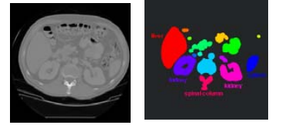
Binary Shape Analysis -Outline
Connected component analysis
Morphological approaches to binary image processing
Geometrical shape properties (descriptors)
Region Identification
Input : a binary image with
several disjoint regions
Output : a labeled image

Slide 4

Binary Shape Analysis
Binary images contain much less information than their grayscale counterparts, they embody shape and size information that is highly relevant for object recognition.
This information resides in a digital lattice of pixels, and this result in intricacies appearing in the geometry.
Examples of Binary Images

Slide 5
Binary Shape Analysis
Consists of a set of image analysis operations that are used to produce or process binary images, usually images of 0’s and 1’s.
0 represents the background
1 represents the foreground
00010010001000
00011110001000
00010010001000

Slide 6

Binary Shape Analysis
Some practical applications are
part inspection
riveting
fish counting
document processing

Slide 7
Binary Shape Analysis
What kinds of operations?
Separate objects from background and from one another
Aggregate pixels for each object
Compute features for each object

Slide 8

Example: red blood cell image
Many blood cells are separate objects
Salt and pepper noise from thresholding

Slide 9
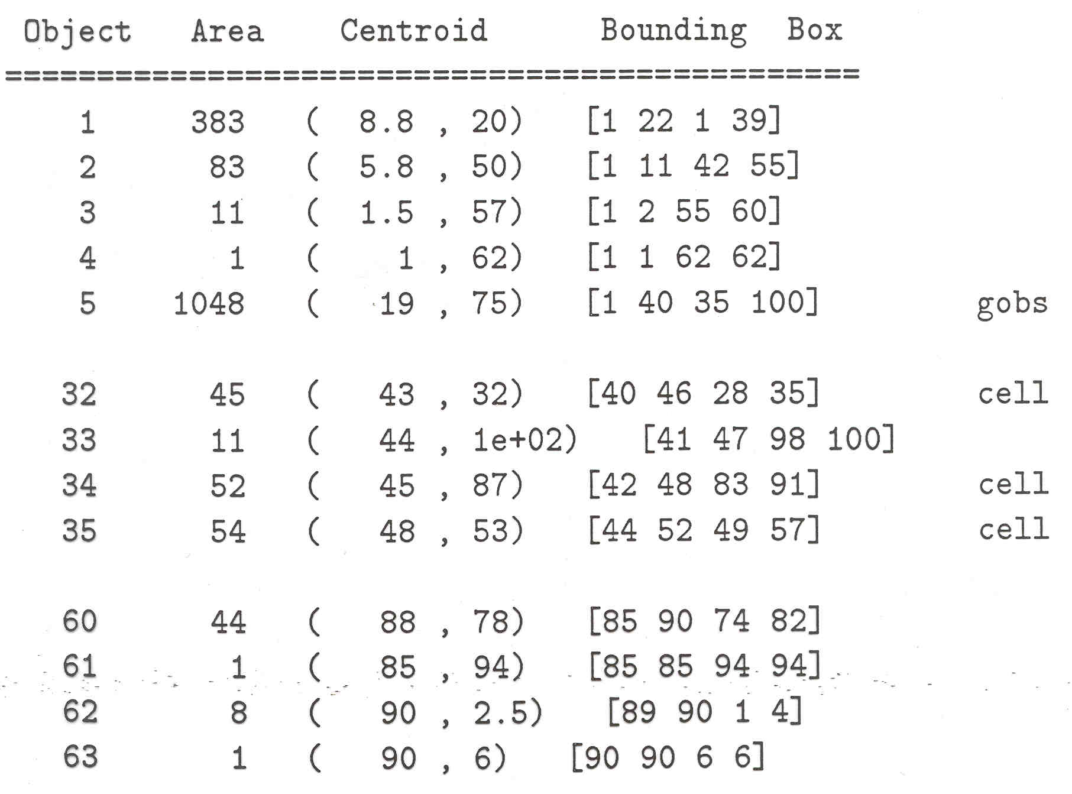
Results Analysis
63 separate objects detected
Single cells have area about 50
Noise spots
Gobs of cells

Slide 10
Useful Operations
1. Thresholding a gray-tone image
2. Determining good thresholds
3. Connected components analysis
4. Binary mathematical morphology
5. All sorts of feature extractors
(area, centroid, circularity, …)

Slide 11
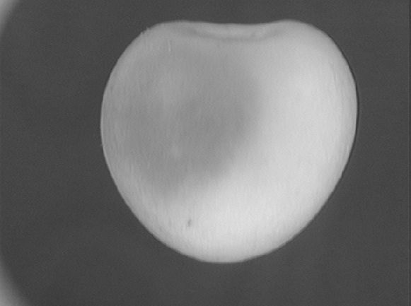

Thresholding
Background is black
Healthy cherry is bright
Bruise is medium dark
Histogram shows two cherry regions (black background has been removed)
pixel
counts
0
gray-tone values
256

Slide 12
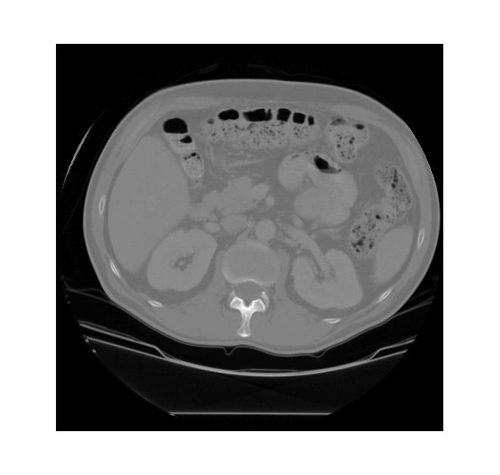
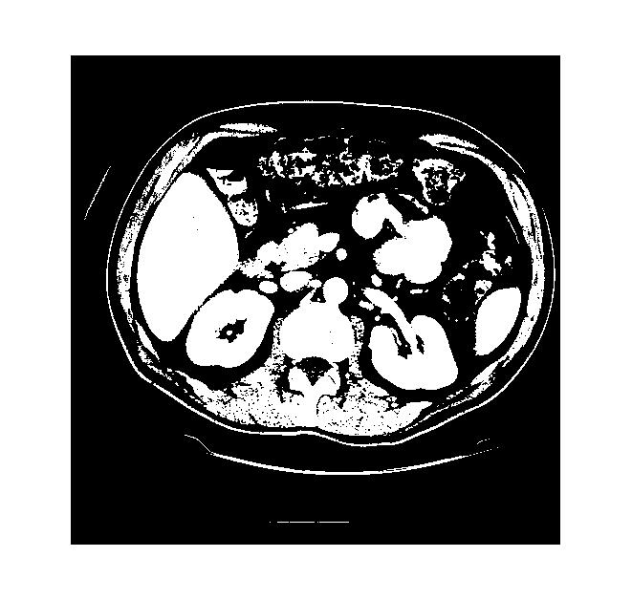
Thresholding Example
original gray tone image
binary thresholded image

Slide 13
2.CONNECTEDNESS IN BINARY IMAGES

Slide 14

CONNECTEDNESS IN BINARY IMAGES
Consider the colored shapes as foreground objects on a white background.

Slide 15


CONNECTEDNESS IN BINARY IMAGES
After Thersholding
Here, we created a mask that only highlights the parts of the image that we find interesting, the objects.
All objects have pixel value of True while the background pixels are False.
By looking at the mask image, one can count the objects that are present in the image.

Slide 16


Connected Components Labeling
Once you have a binary image, you can identify and
then analyze each connected set of pixels.
The connected components operation takes in a binary image and produces a labeled image in which each pixel has the integer label of either the background (0) or a component.
binary image after morphology
connected components

Slide 17
Connected Components Labeling
Original Binary Image
0 0 0 1 1 1 0 0 0 0 1 1 1 1 0 0 0 0 1
0 0 0 1 1 1 1 0 0 0 1 1 1 1 0 0 0 1 1
0 0 0 1 1 1 1 1 0 0 1 1 1 1 0 0 1 1 1
0 0 0 1 1 1 1 1 1 0 1 1 1 1 0 0 1 1 1
0 0 0 1 1 1 1 1 1 1 1 1 1 1 0 0 1 1 1
0 0 0 1 1 1 1 1 1 1 1 1 1 1 0 0 1 1 1
0 0 0 1 1 1 1 1 1 1 1 1 1 1 1 1 1 1 1
0 0 0 1 1 1 1 1 1 1 1 1 1 1 1 1 1 1 1
0 0 0 1 1 1 1 1 1 0 0 0 0 0 1 1 1 1 1

Slide 18
Equivalent Labels
The Labeling Process
0 0 0 1 1 1 0 0 0 0 2 2 2 2 0 0 0 0 3
0 0 0 1 1 1 1 0 0 0 2 2 2 2 0 0 0 3 3
0 0 0 1 1 1 1 1 0 0 2 2 2 2 0 0 3 3 3
0 0 0 1 1 1 1 1 1 0 2 2 2 2 0 0 3 3 3
0 0 0 1 1 1 1 1 1 1 1 1 1 1 0 0 3 3 3
0 0 0 1 1 1 1 1 1 1 1 1 1 1 0 0 3 3 3
0 0 0 1 1 1 1 1 1 1 1 1 1 1 1 1 1 1 1
0 0 0 1 1 1 1 1 1 1 1 1 1 1 1 1 1 1 1
0 0 0 1 1 1 1 1 1 0 0 0 0 0 1 1 1 1 1
1 ≡ 2
1 ≡ 3

Slide 19
Pixel Neighbhourhood
In order to decide which pixels belong to the same object, one can exploit their neighbourhood: pixels that are directly next to each other and belong to the foreground class can be considered to belong to the same object.
Let’s consider the following mask “image” with 8 rows, and 8 columns. Note that for brevity, 0 is used to represent False (background) and 1 to represent True (foreground).
0 0 0 0 0 0 0 0
0 1 1 0 0 0 0 0
0 1 1 0 0 0 0 0
0 0 0 1 1 1 0 0
0 0 0 1 1 1 1 0
0 0 0 0 0 0 0 0
The pixels are organized in a rectangular grid. In order to understand pixel neighborhoods

Slide 20
3.OBJECT LABELING AND COUNTING

Slide 21
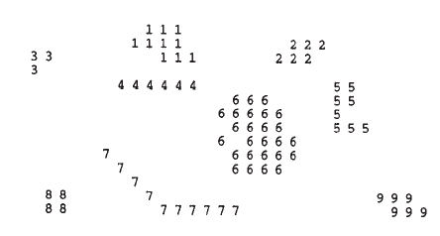
OBJECT LABELING AND COUNTING
Labeling may be achieved by scanning the image sequentially until a 1 is encountered on the first object; a note is then made of the scanning position, and a “propagation” routine is initiated to label the whole of the object with a 1.
since the original image space is already in use, a separate image space has to be allocated for labeling.
Next, the scan is resumed, ignoring all points already labeled, until another object is found; this is labeled with a 2 in the separate image space.
This procedure is continued until the whole image has been scanned and all the objects have been labeled
A process in which all binary objects are labeled

Slide 22
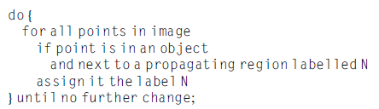
ALGORITHM FOR OBJECT LABELING
the for forward scan over image do {…..} notation denotes a sequential forward raster scan over the image.

Slide 23
ALGORITHM FOR OBJECT LABELING
Object counting and labeling routine requires a minimum of 2N+1 passes over the image space, and in practice the number will be closer to NW/2, where W is the average width of the objects.
Hence, the algorithm is inherently rather inefficient.
This prompts us to consider how the number of passes over the image could be reduced to save computation.
One possibility would be to scan forward through the image, propagating new labels through objects as they are discovered.

Slide 24
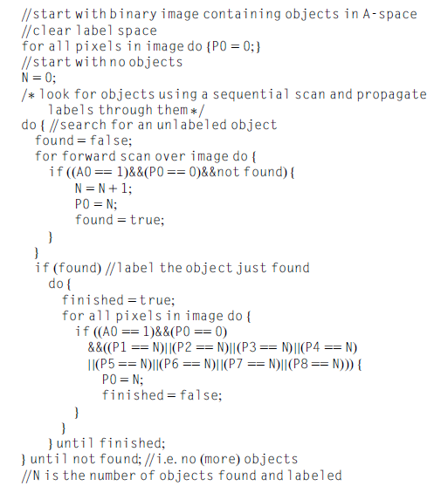
A Simple Algorithm for Object Labeling

Slide 25
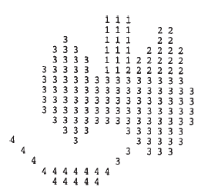
Labeling U-shaped objects
The least computationally intensive procedures for propagation involve a different approach: objects and parts of objects are labeled on a single sequential pass through the image, at the same time noting which labels coexist on objects.
Then the labels are sorted separately, in a stage of abstract information processing, to determine how the initially rather ad hoc labels should be interpreted.
Finally, the objects are relabeled appropriately in a second pass over the image.

Slide 26
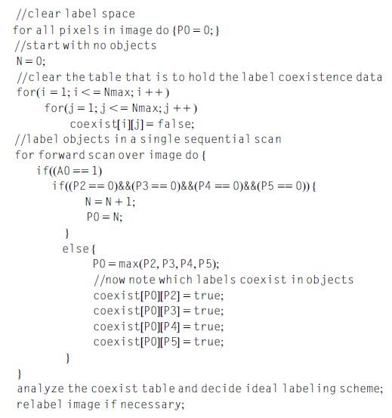
Improved Algorithm for Object Labeling
Clearly this algorithm with its single sequential scan is intrinsically far
more efficient than the previous one

Slide 27
Improved Algorithm for Object Labeling
The improved above algorithms permit the areas and perimeters of objects to be determined: thus, objects may be labeled by their areas or perimeters instead of by numbers representing their order of appearance in the image.
More important, the availability of propagation routines means that objects can be considered in turn in their entirety—if necessary by transferring them individually to separate image spaces or storage areas ready for unencumbered independent analysis.
Evidently, if objects appear in individual binary spaces, maximum and minimum spatial coordinates are trivially measurable, centroids can readily be found and more detailed calculations of moments and other parameters can easily be undertaken.

Slide 28
3.1 Solving the Labeling Problem in a More Complex Case

Slide 29
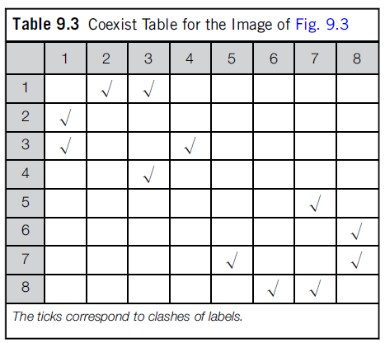
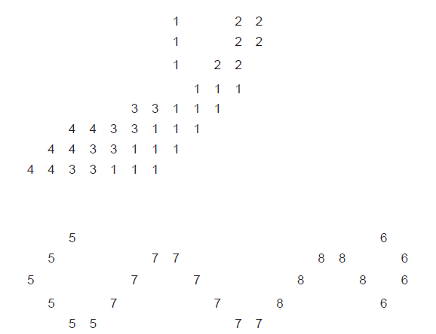
Solving the Labeling Problem in a More Complex Case
Fig 9.3
Sequential labeling has been carried out in line with the improved algorithm.
However, one variation has been adopted—of using a minimum rather than a maximum labeling convention, so that the values are in general slightly closer to the eventual ideal labels.

Slide 30
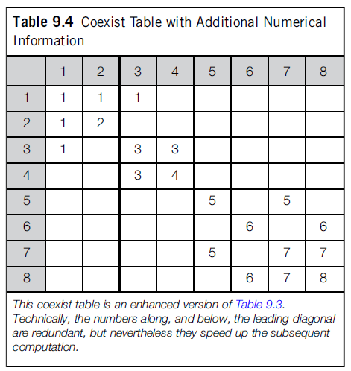
Step 1
However, the whole process of calculating ideal labels can be made more efficient by inserting numbers instead of ticks, and also adding the right numbers along the leading diagonal

Slide 31
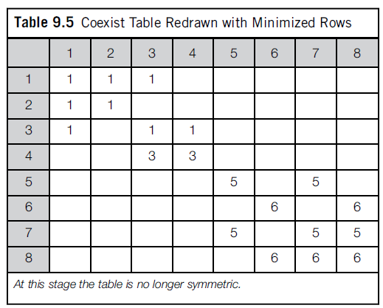
Step 2
The next step is to minimize the entries along the individual rows of the table

Slide 32
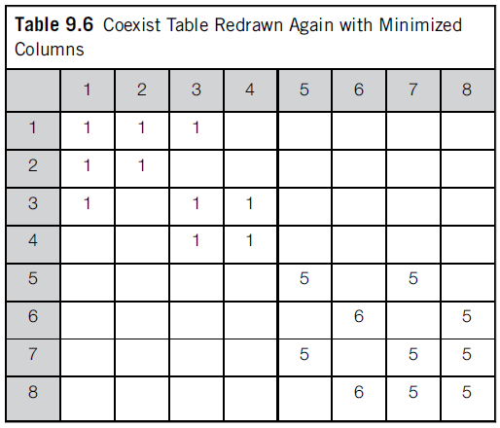
Step 3
Then we minimize along the individual columns

Slide 33
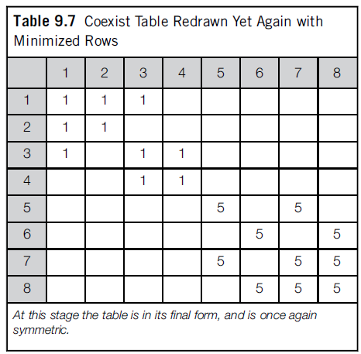
Step 4
Then we minimize along rows again

Slide 34
4. Size Filtering

Slide 35


Size Filtering
The 8- connected and 4-connected definitions of connectedness lead to the following measures of distance (or “metrics”) that apply to pairs of pixels, labeled i and j, in a digital lattice:
While the use of the d4 and d8 metrics is bound to lead to certain inaccuracies, there is a need to see what can be achieved with the use of local operations in binary images.

Slide 36


Size Filtering
The basic idea is that small objects may be eliminated by applying a series of shrink operations.
In N shrink operations will eliminate an object (or those parts of an object) that are 2N or fewer pixels across their narrowest dimension.
This process shrinks all the objects in the image, but in principle a subsequent N expand operations will restore the larger objects to their former size.

Slide 37
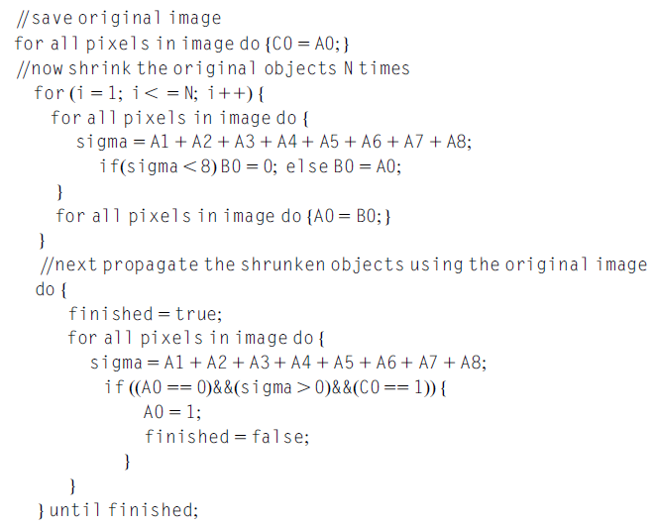
Algorithm for Recovering Original Forms of Shrunken Objects

Slide 38
Explanation
Whole (connected) objects can be removed that are everywhere narrower than a specified width, it is possible to devise algorithms for removing any subset of objects that are characterized by a given range of widths: large objects may be filtered out by first removing lesser-sized objects and then performing a logical masking operation with the original image, while intermediate size objects may be filtered out by removing a larger subset and then restoring small objects that have previously been stored in a separate image space.
Finally, note that expand operations followed by shrink operations may be useful for joining nearby objects, filling in holes, and so on.
Numerous refinements and additions to these simple techniques are possible.

Slide 39
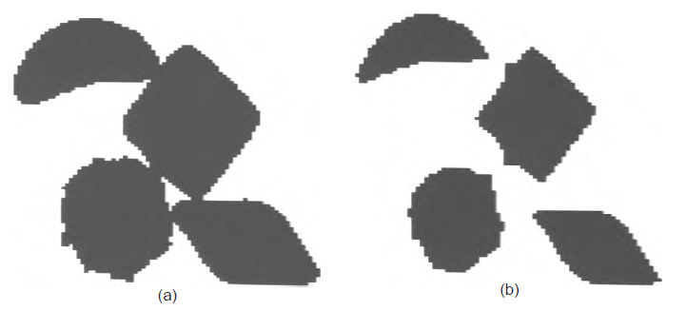
Separation of touching objects by shrink operations.
Figure Shown is the objects (chocolates) in (a) are shrunk and (b) in order to separate them so that they may be counted reliably.

